Slide 1
Fall 2021 Pre-calculus
Lesson 11.1
Dr. O’Brien
Lehman High School
November 29, 2021
Notes:
Circles of evaluation
Yret

Slide 2
Do now
be sure to: find seat. Get out your binder and answer the do now questions below. Show all work or answer each question with a complete sentence.
Do you think the expression to the right will give you a syntax error if you type it into a calculator? Explain why or why not.
What do you think the phrase ‘syntax error’ means? Explain in a sentence.
((1+2) * 3
Notes:
Yes because there’s two left parens but only one right parens
Syntax refers to the rules for what’s an acceptable expression. For instance in math there’s a rule that whenever you have a left parens you also need a right parens. A syntax error is an expression that breaks one or more rules.

Slide 3
framing
what: write expressions that produce Numbers, Strings, and Booleans
why: In this unit we’ll be applying our mathematical knowledge to make a video game using the programming language Pyret
where to: Next we learn how to implement in functions in Pyret

Slide 4
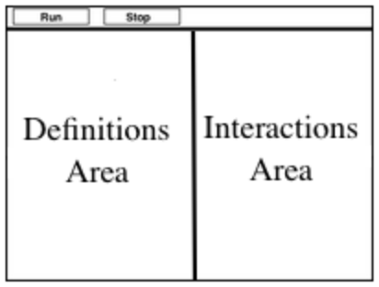
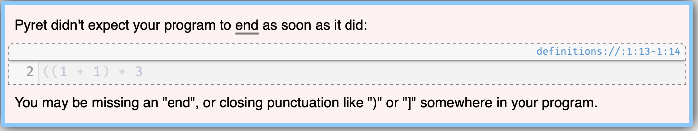
Coding to learn
be sure to: Open your computer. Navigate to code.pyret.org. Read instructions below
Click “sign in”. Use your Lehman email to make an account
Click “open editor”.
With your partner, complete the Numbers & Strings worksheet.
Pay special attention to error messages!
When you’re done, turn over your worksheet and work on the Booleans assignment!
Notes:
Remind students about definitions area and interactions area.
+Why is it useful to pay attention to error messages? because they tell you exactly what’s going wrong.

Slide 5
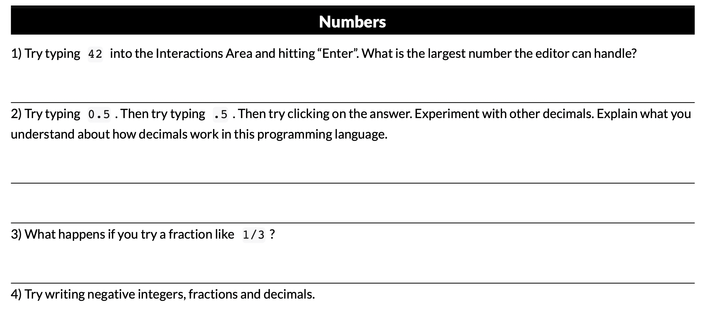
Coding to learn
be sure to: Work through these problems with your partner.
Notes:
there’s no limit to what the editor can handle
you need to have somthing to the left of the ‘.’. so .5 gives you an error message. Fortunately the Pyret editor gives you an error message telling you exactly this.
It evaluates to a decimal. If you click on it changes beck and forth between decimal and fraction form.
it evaluates to a negative number.

Slide 6
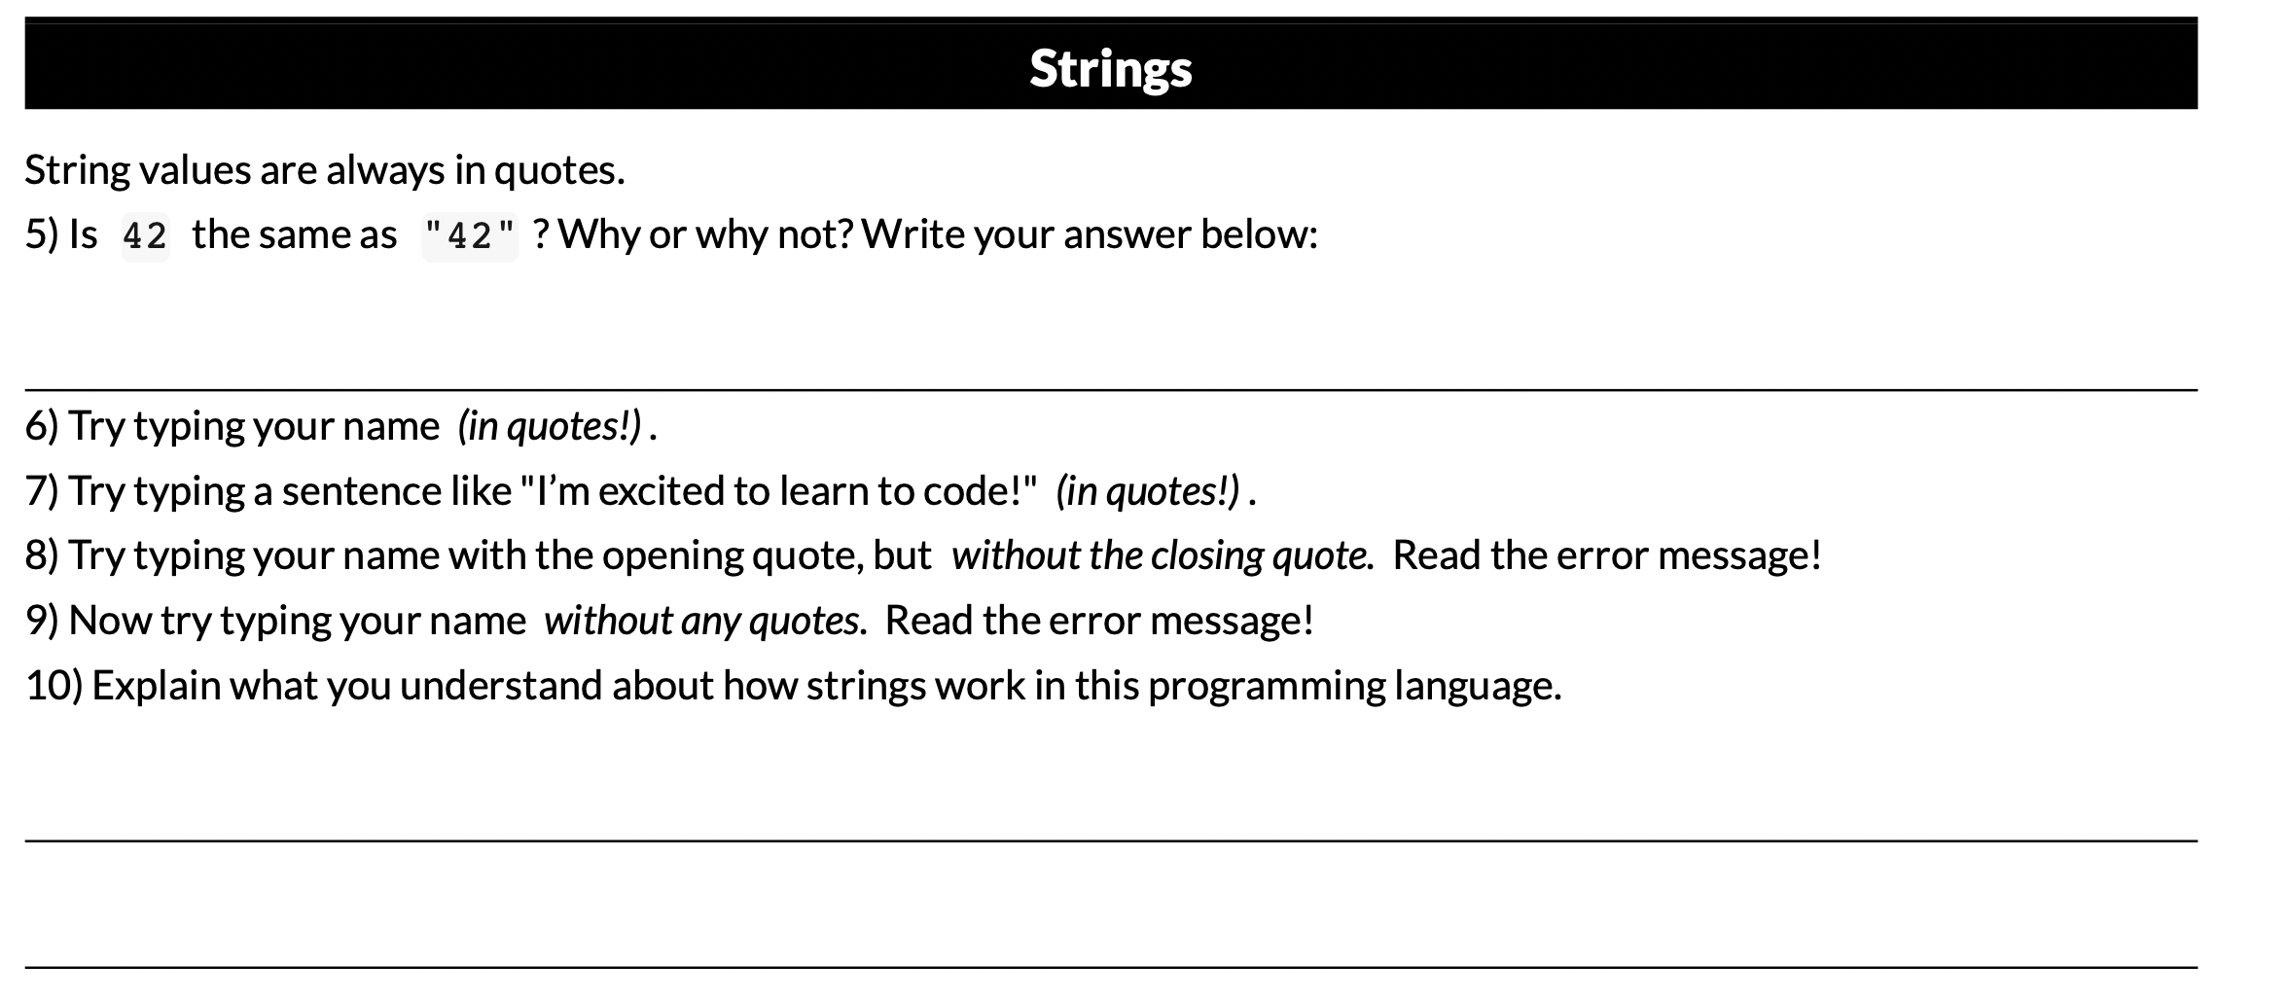
Coding to learn
be sure to: Work through these problems with your partner.
Notes:
5. No, one is a number one is a string.
10. answers will vary. strings have to have two quotation marks surrounding them. If a number is surrounded by “” it will evaluate to a string, otherwise it will be a number. Regular words without quotation marks will give you an error message.

Slide 7
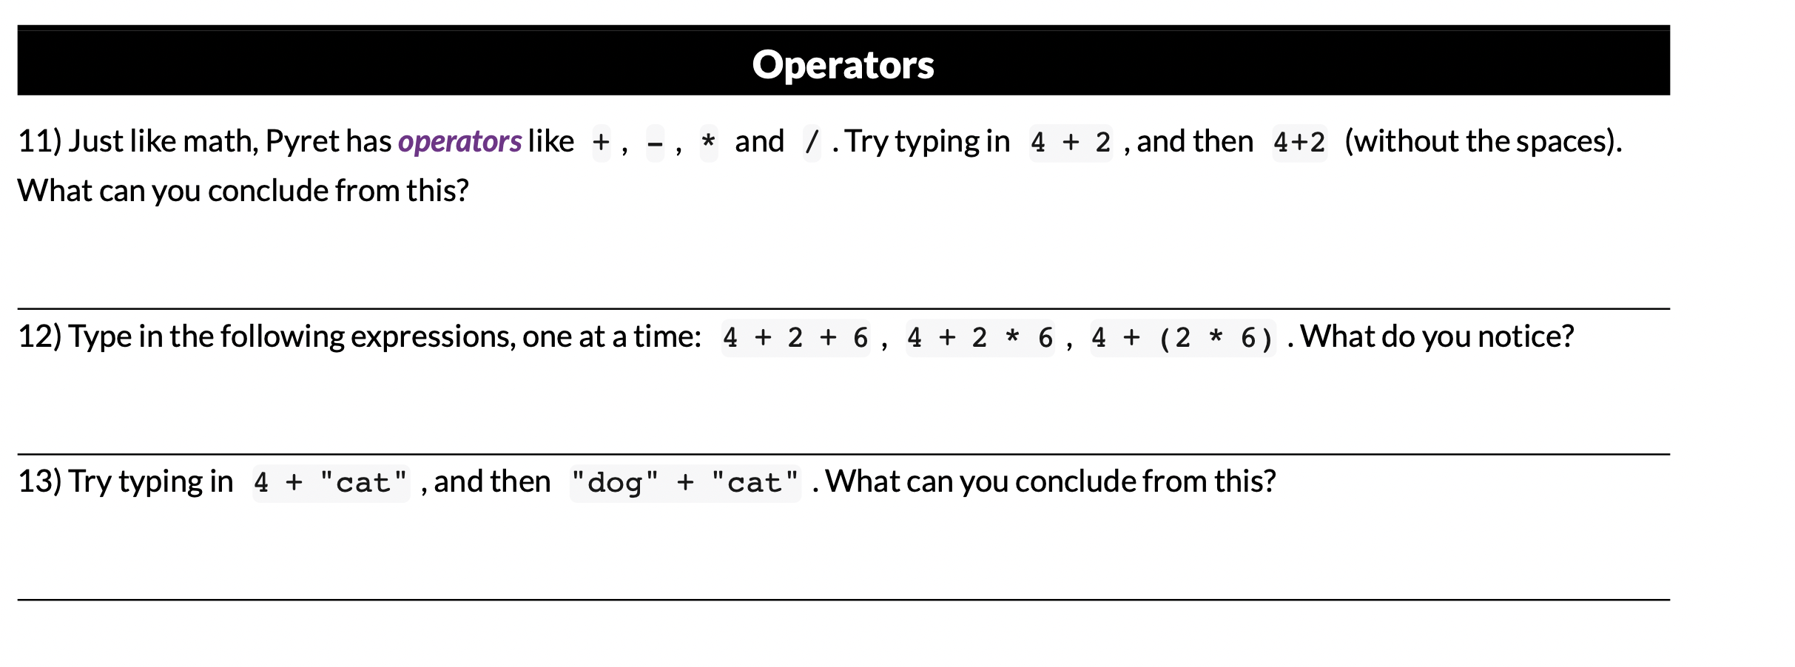
Coding to learn
be sure to: Work through these problems with your partner.
Notes:
11. you need to have spaces separating the number from the operator.
12. If all operators are + it doesn’t need (). Otherwise you need () to tell Pyret which expression to evaluate first. +What about 4 + 2 - 6? this also needs ().
13. this freaks out. you can’t combine strings and numbers.
+Can you have an expresion like “cat” + “dog”? yes, this is actually called concatenation and it gives you “catdog”.

Slide 8
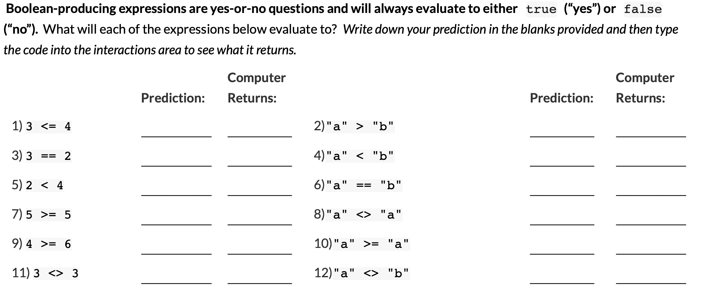
Coding to learn
be sure to: Work through these problems with your partner.
Notes:
Student should read top paragraph.
See teacher resources for answers. This exercise let’s students figure out from experience what boolean operators do.

Slide 9
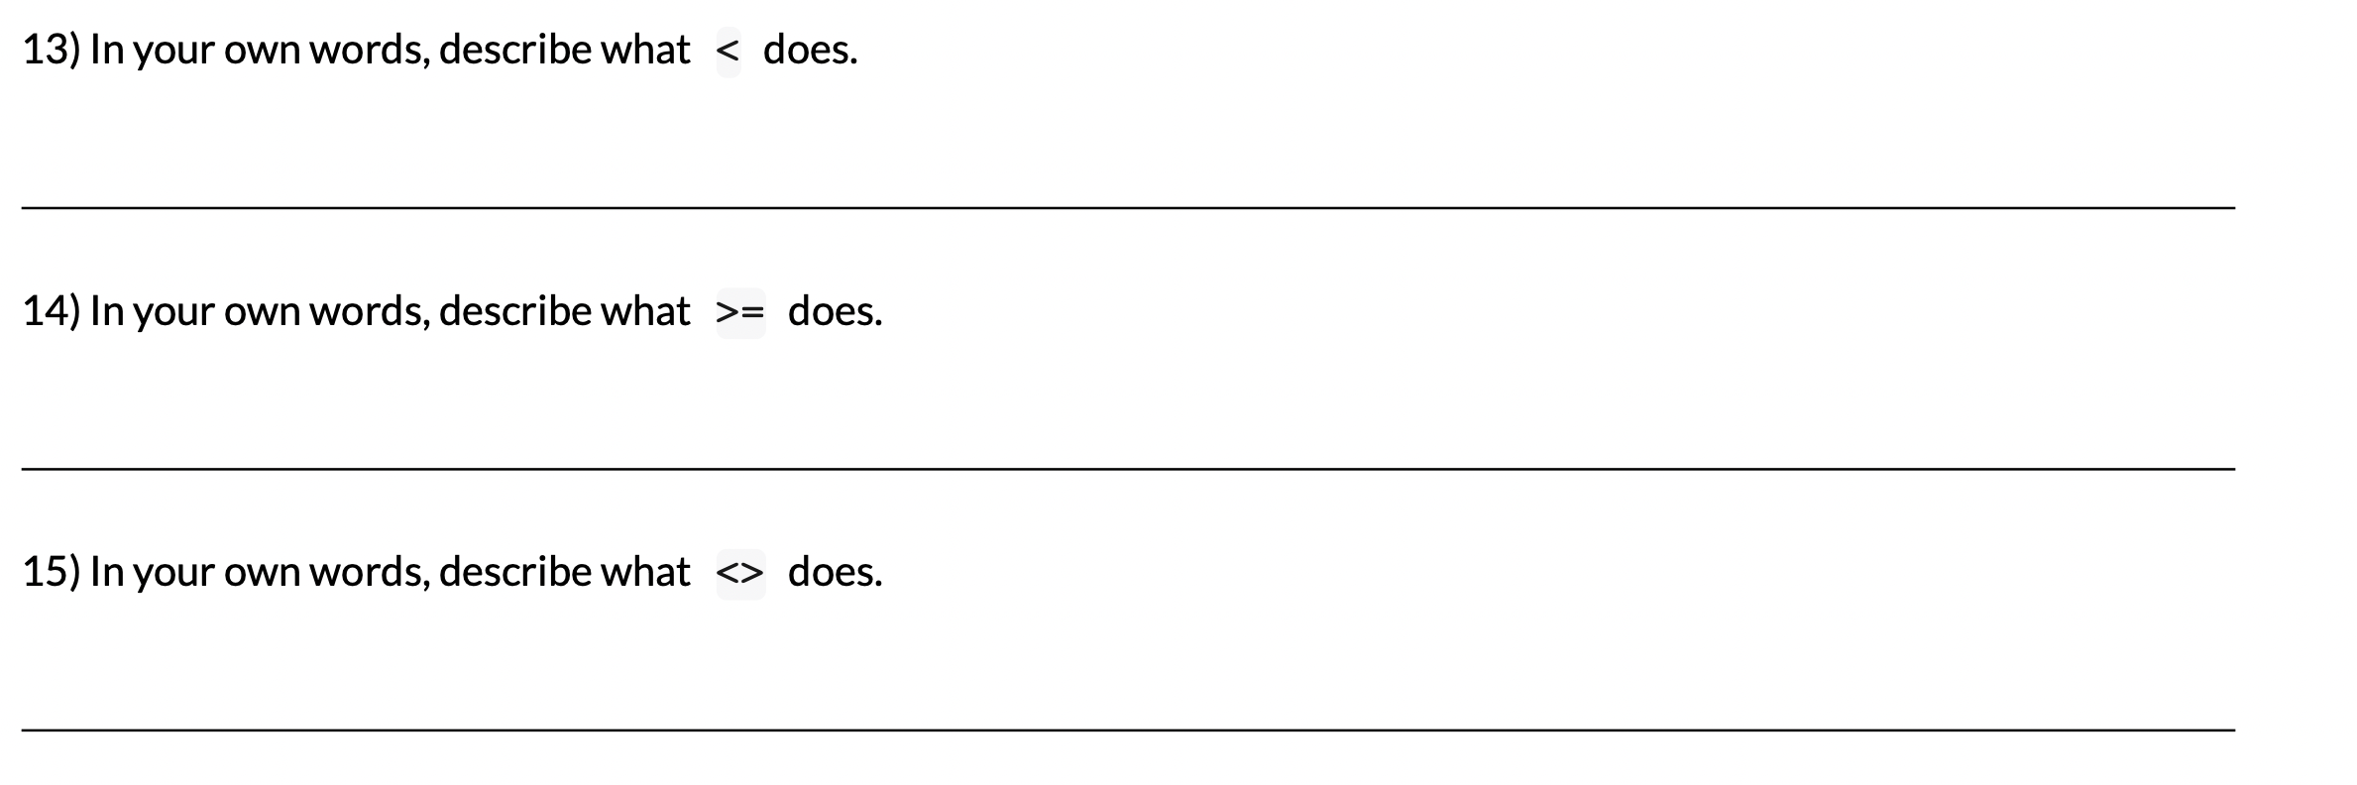
Coding to learn
be sure to: Work through these problems with your partner.
Notes:
13. ‘<‘ is less than
14. “>=“ is greater than or equal to
15. <> is not equal to.

Slide 10
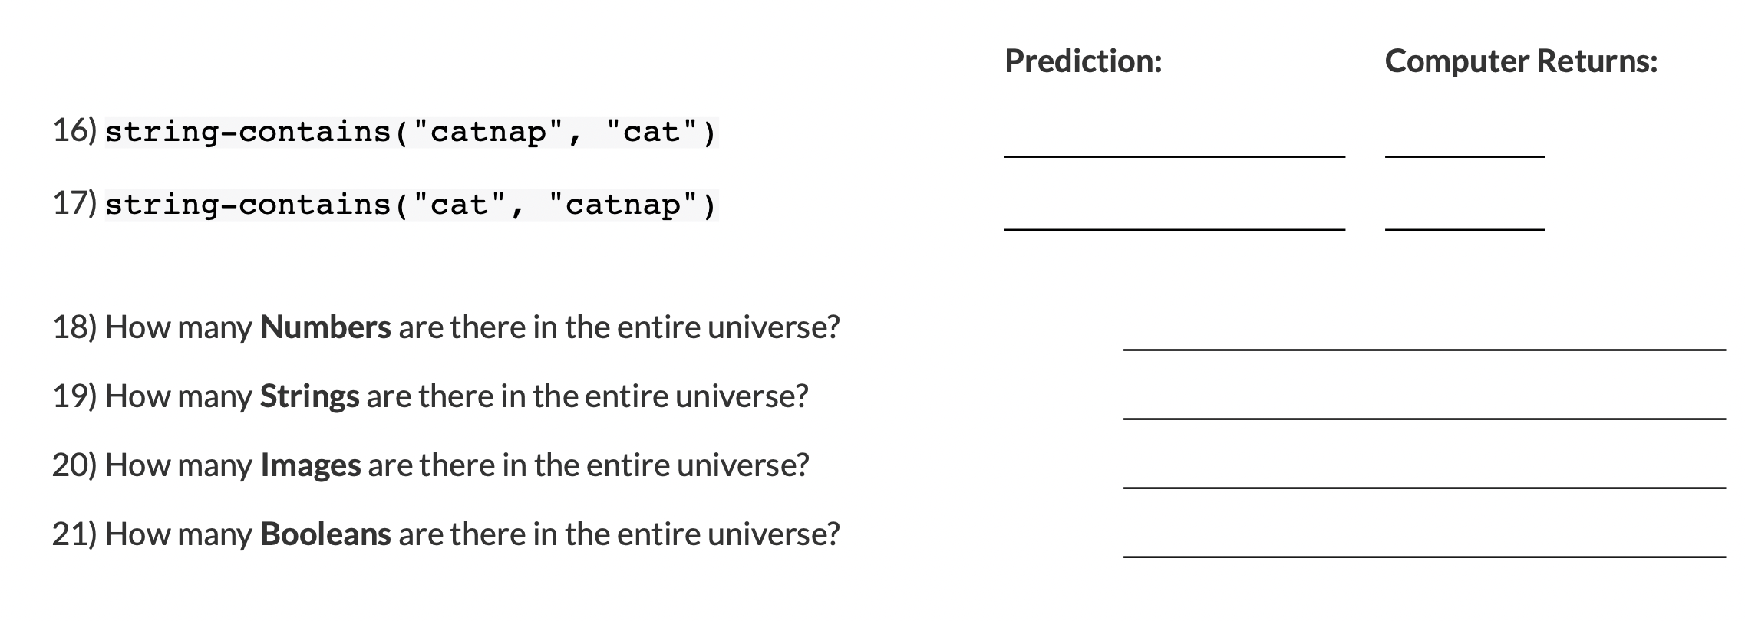
Coding to learn
be sure to: Work through these problems with your partner.
Notes:
Students might need help with the ‘whole’ universe question.

Slide 11
d
Reflection: Thinking about thinking
be sure to: Answer each question below with a complete sentence.
What sets Booleans apart from other data types?
Why do you think <> was selected to represent not equal?
Any questions about what any of the other Boolean operators do?
Notes:
-Booleans are truth values (true, false).
it can’t represent other comparison operators, because you can’t be both greater than and less than.
questions will vary. students may have questions about the questions about ‘universe’? 18-22

